Slide 1
Lecture 6
Control Statements, Loop, Functions

Slide 2
Learning Objectives Today
If-else
Nested If-else
Loop
Nested Loop
Functions
Parameters

Slide 3
Control Statements
Control statements in Python are essential for directing the flow of a program's execution. They include if/else, for/while, break/continue, and pass statements. These statements enable logic, decision-making, and looping in Python programs. Conditional statements like if-else allow for executing code based on specific conditions, while loops like for and while enable repetitive execution of code. Functions in Python help encapsulate and reuse code blocks. Control statements are crucial for creating versatile and resilient Python programs that can make decisions, perform repetitive tasks, and execute in a nonlinear manner

Slide 4
Control Statements
If-Else
Decision Making
Match

Slide 5
If-Else
marks = 80
result = ""
if marks < 30:
result = "Failed"
elif marks > 75:
result = "Passed with distinction"
else:
result = "Passed"
print(result)

Slide 6
Remember Lecture 5??

Slide 7
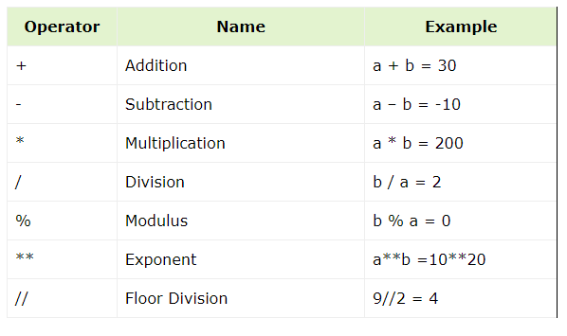
Python Operators (Arithmatic)

Slide 8
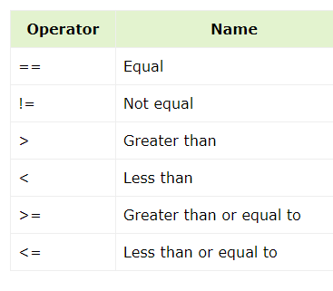
Python Operators (Comparison)

Slide 9
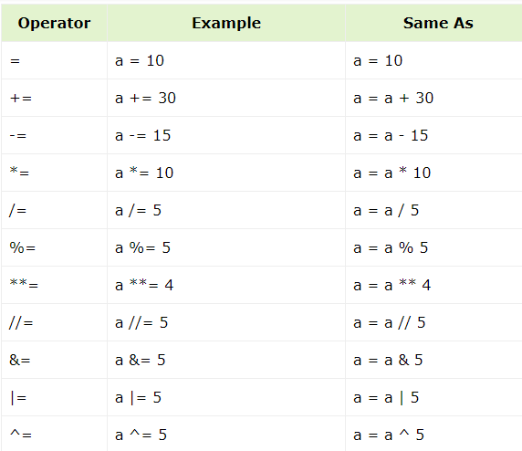
Python Operators (Assignment)

Slide 10
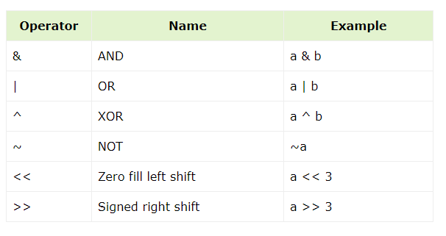
Python Operators (Bitwise)

Slide 11
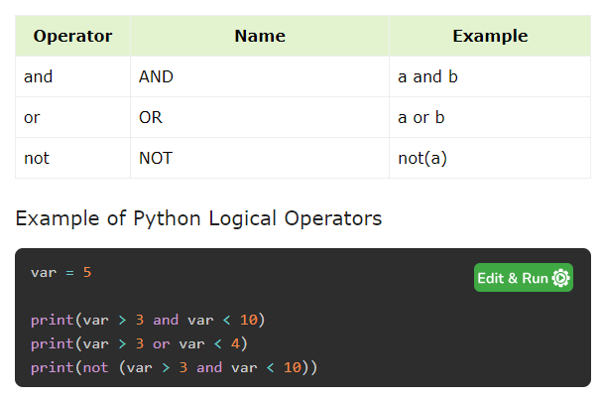
Python Operators (Logical)

Slide 12
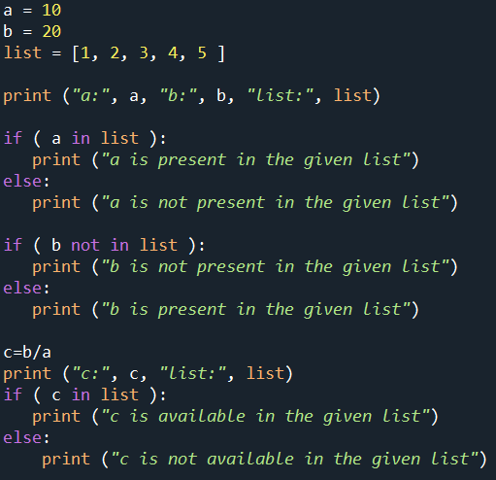
Python Operators (In and Not-in)

Slide 13
Coming Back to If-Else

Slide 14
If-else
day = "Tuesday"
if day == "Saturday" or day == "Sunday":
print("Enjoy your weekend!")
else:
print("Go to work!")

Slide 15
If-Else
How about calculating the condition before
day = "Tuesday"
is_weekend = day == "Saturday" or day == "Sunday"
if not is_weekend:
print("Go to work!")
else:
print("Enjoy your weekend!")

Slide 16
Multiple If-Else
score = 85
if score >= 90:
print("Grade: A")
elif score >= 80:
print("Grade: B")
elif score >= 70:
print("Grade: C")
else:
print("Grade: F")

Slide 17
Try-Out
Write a program that generates a random number between 1 and 10. Ask the user to guess the number. Use if-else statements to check if the guess is correct, too high, or too low, and provide appropriate messages.
Hint:
import random # Generate a random number between 1 and 10 secret_number = random.randint(1, 10)

Slide 18
Try-Out
Write a program that asks the user for a year. Use if-else statements with appropriate conditions (considering divisibility by 4 and 100) to determine if the year is a leap year. Print "Leap Year" or "Not a Leap Year".
Write a program that asks the user for their exam score. Use if-else statements with a series of conditions to assign letter grades (e.g., A for 90-100, B for 80-89, etc.). Print the assigned letter grade.

Slide 19
Try-Outs
Simple Password Checker: Write a program that asks the user to create a password. Use if-else statements to check if the password meets certain criteria (e.g., minimum length, containing uppercase and lowercase letters). Print a message indicating if the password is valid or not.

Slide 20
Nested If-Else
num1 = 10
num2 = 20
if num1 > num2:
print("num1 is greater")
else:
if num1 == num2:
print("num1 and num2 are equal")
else:
print("num2 is greater")

Slide 21
Check a list?
requested_toppings = ['mushrooms', 'extra cheese']
if 'mushrooms' in requested_toppings:
print("Adding mushrooms.")
elif 'pepperoni' in requested_toppings:
print("Adding pepperoni.")
elif 'extra cheese' in requested_toppings:
print("Adding extra cheese.")
print("\nFinished making your pizza!")

Slide 22
Match Statement
def weekday(n):
match n:
case 0: return "Monday"
case 1: return "Tuesday"
case 2: return "Wednesday"
case 3: return "Thursday"
case 4: return "Friday"
case 5: return "Saturday"
case 6: return "Sunday"
case _: return "Invalid day number"
print (weekday(3))
print (weekday(7))

Slide 23
Loop
A loop is a programming construct that allows you to execute a block of code repeatedly until a certain condition is met. It's a fundamental concept for iterating over data or performing actions multiple times.

Slide 24
For Loop
for var in iterable: # statements

Slide 25
For Loop
for i in range(0, 10, 2):
print(i)
0
2
4
6
8

Slide 26
For Loop
l1 = ["eat", "sleep", "repeat"]
for ele in l1:
print (ele)
#########################################
l1 = ["eat", "sleep", "repeat"]
for count, ele in enumerate(l1):
print (count, ele)

Slide 27
Nested For Loop
for i in range(1, 4):
for j in range(1, 4):
print(i, j)

Slide 28
Try-Out
Imagine, there are two lists. Now, check if elements from list A are available in list B or not.
Imagine, there are two lists containing student ids and student names. Print them in the following pattern:
ID --- Name

Slide 29
Continue Statement
for letter in 'HelloWorld!':
if letter == 'o' or letter == 'w':
continue
print('Current Letter :', letter)
for i in range(0,10):
if i%2==0:
continue
else:
print("Odd",i)

Slide 30
Break
for i in range(0,10):
if i==5:
break
else:
print(i)

Slide 31
While Loop
# Python program to illustrate
# while loop
count = 0
while (count < 3):
count = count + 1
print("Hello Geek")

Slide 32
Practice! Practice! Practice!

Slide 33
Python Function
def greet(name):
"""Greets the user by name.
Args:
name: The name of the person to greet (str).
Returns:
A string containing the greeting message.
"""
message = f"Hello, {name}!"
return message
name = greet("Atanu")
print(name)

Slide 34
Pass by Reference
def testfunction(arg):
print ("ID inside the function:", id(arg))
arg=arg+1
print ("new object after increment", arg, id(arg))
var=10
print ("ID before passing:", id(var))
testfunction(var)
print ("value after function call", var)

Slide 35
Keyword Argument
# Function definition is here
def printinfo( name, age ):
print ("Name: ", name)
print ("Age ", age)
return
printinfo ("Naveen", 29)
# by keyword arguments
printinfo(name="miki", age = 30)

Slide 36
Passing List in Function
def list_mod(my_list):
current_item = my_list.pop()
print(current_item.title())
one_list = ['john', 'marry', 'rock']
print("Before",one_list)
list_mod(one_list)
print("After",one_list)
Main List Modified

Slide 37
Passing List in Function
def list_mod(my_list):
current_item = my_list.pop()
print(current_item.title())
one_list = ['john', 'marry', 'rock']
print("Before",one_list)
list_mod(one_list[:])
print("After",one_list)

Slide 38
Default Parameter and Styling Function
def func(
param1, param2="okay",
param3="Default", param4=""):
print("This one works too")
func("Atanu")

Slide 39
Global Variable
def testfunction(arg):
global var
var +=1
var=10
print ("Variable before passing:", var)
testfunction(var)
print ("value after function call", var)

